Slide 1
Blockchain Security
Blockchain based Smart Contract Security
Dr. Kunwar Singh
CSE Department
NIT Trichy

Slide 2
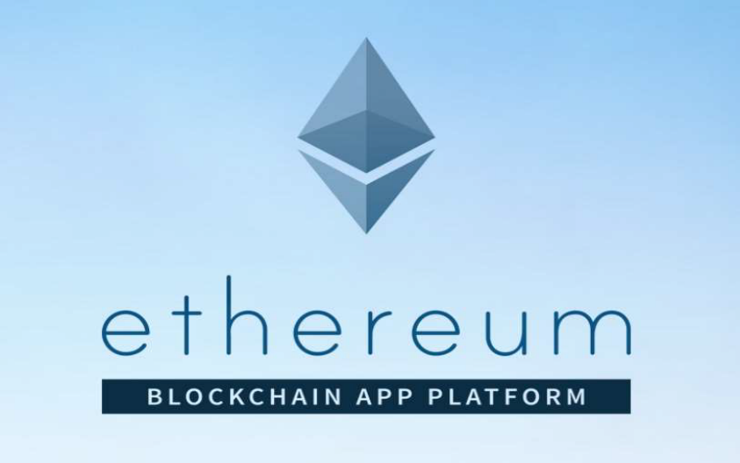
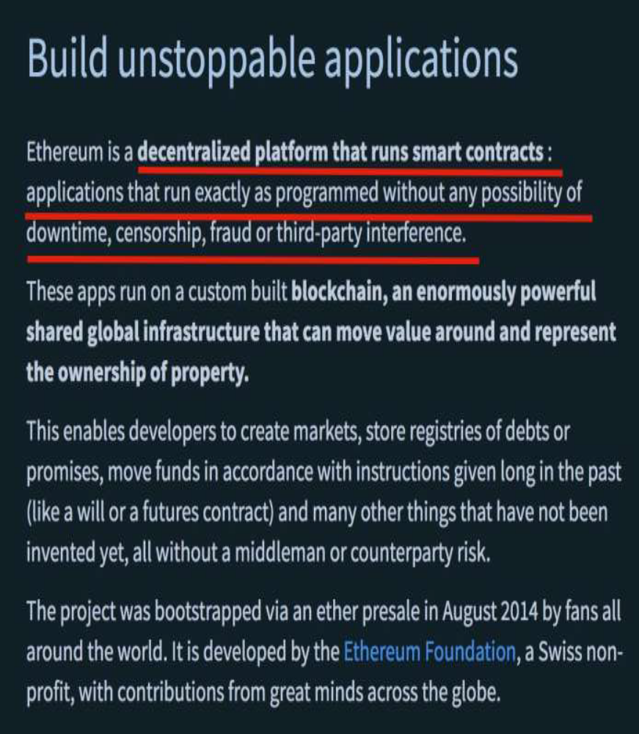
Blockchain 2.0
It’s more than
cryptocurrency

Slide 3
Ethereum blockchain
Blockchain 2.0
Ethereum Blockchain is the most popular Blockchain for developing smart contracts.
Ethereum is a public or private Blockchain with a built-in Turing-complete language to allow writing any smart contract.
Ethereum is account based unlike Bitcoin (transaction based)
The Ethereum Virtual Machine (EVM), which can execute scripts using an international network of public nodes. Contracts are written in specic programming languages such as Solidity [Sola]. Once compiled to bytecode, the contract can be read and executed by the Ethereum virtual machine (EVM)’
Ether is a cryptocurrency in Ethereum network.

Slide 4
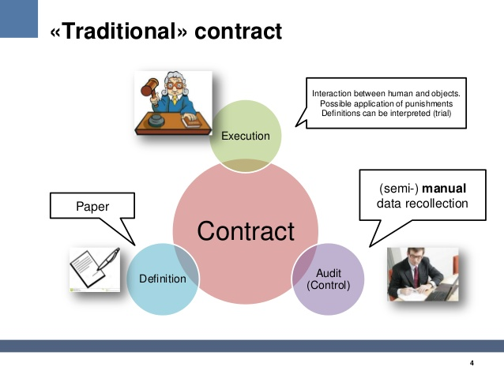
Notes:
Taken from https://www.slideshare.net/philippecamacho/smart-contracts

Slide 5
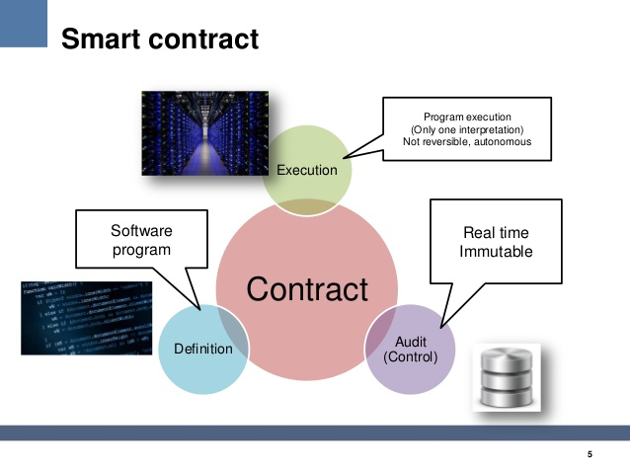

Slide 6

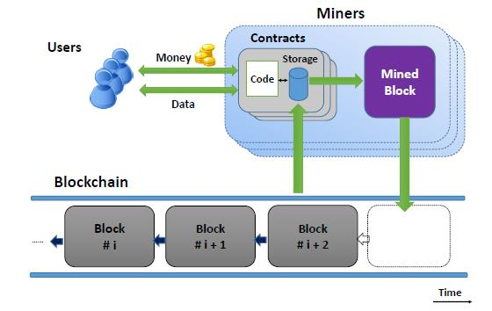
Smart Contracts (Nick Szabo in 1994)
A smart contract is an executable code that runs on the Blockchain to facilitate, execute and enforce agreement between untrusted parties without the involvement of a trusted third party.
Smart contracts can be called through transactions. Smart contracts are irreversible and immutable.

Slide 7
B. Smart Contract Programming
Solidity is an object-oriented, contract oriented, high-level language for implementing smart contracts.
Smart contracts are programs which govern the behaviour of accounts within the Ethereum state.
Solidity is statically typed, supports inheritance, libraries and complex
user-defined types among other features.

Slide 8
contract Counter
pragma solidity ^0.4.19;
contract Counter
{ int private count = 0;
function incrementCounter() public { count += 1; }
function decrementCounter() public { count -= 1; }
function getCount() public returns (int) {
return count; }
}

Slide 9

Pragma
It is a directive that specifies the compiler version to be used for current solidity file.
The version number comprises of two number- major build and minor build number
ex:
pragma Solidity ^0.4.19;
where 4 as major build and 19 as minor build number.

Slide 10
Functions
When a function in a contract is called,it results in the creation of a transaction.
The visibility of a function can be any one of the following :
  public: function access can be directly from outside
  internal: It means this function can be used within the current contract and any other contract that inherits from it.

Slide 11
Cont>>
private: private function can only be used in contracts declaring them. they can not be used even within derived contracts.
external: This makes function access directly from externally but not internally.
Default function is Public
Default variable is internal

Slide 12
Mapping
Mapping is similar to hash table or dictionary in other languages storing key-value pair.

Slide 13
Constructor
In other programming languages, a constructor is executed whenever a new object instance is created. However in Solidity, whenever smart contract is deployed into blockchain constructor function is instantiated (called).
There can be atmost one constructor (unlike other languages)
It does not return any data explicitly
Has the same name as contract
Can take parameters

Slide 14
contract Counter
pragma solidity ^0.4.19;
contract Counter
{ int private count;
function Counter() public { count = 0;}
function incrementCounter() public { count += 1; }
function decrementCounter() public { count -= 1; }
function getCount() public returns (int) {
return count; }
}

Slide 15
Minning
Consensus Algorithm (Proof of Work):
1. New transactions are broadcast to all nodes.
2. Special nodes(miner) track transactions and add them to “candidate block”. Due to transaction ordering issues, candidate blocks in each miner may be different.
3. Special node which solves hash puzzle will be able to add new block into Blockchain. This node (called miner) will be rewarded 5 ether.
4. Other nodes accept the block only if all transactions in it are valid (unspent, valid signatures)
5. Nodes express their acceptance of the block by working on creating the next block
Disadvantage: requires huge amounts of energy. 54 TWe per year. Which is electricity requirement of New Zealand or Hungary.

Slide 16
Proof of Stake (PoS)
Attributing mining power to the proportion of coins held by a miner.
Suppose Alice has 20% of the total coins and Bob has 15% of the total coins. Alice will be given 20% of total nodes and so Bob.
One node is randomly chosen as minor.
assumption that a majority of the wealth in the system is controlled by honest participants.
The rationale behind PoS is that users who have significant stakes in the system have an economic incentive in keeping the system running according to the protocol specification, as they risk that their stakes will become worthless if trust in the cryptocurrency vanishes.

Slide 17
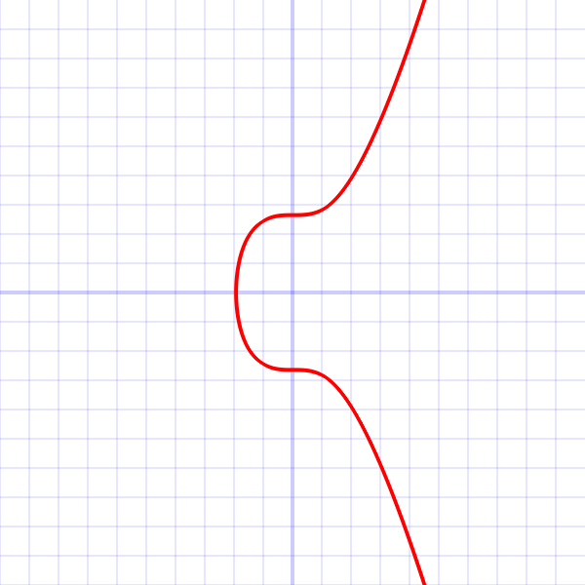
ECDSA in Ethereum is same as Bitcoin
secp256k1 curve (same as Bitcoin) parameters
G = (x, y) is the generator of cyclic subgroup of elliptic group
Where X = 79BE667E F9DCBBAC 55A06295 CE870B07
029BFCDB 2DCE28D9 59F2815B 16F81798
Y = 483ADA77 26A3C465 5DA4FBFC 0E1108A8
FD17B448 A6855419 9C47D08F FB10D4B8
secp256k1's elliptic curve
order(G) = q is a prime,
where q = FFFFFFFF FFFFFFFF FFFFFFFF
FFFFFFFF BAAEDCE6 AF48A03B
BFD25E8C D0364141

Slide 18
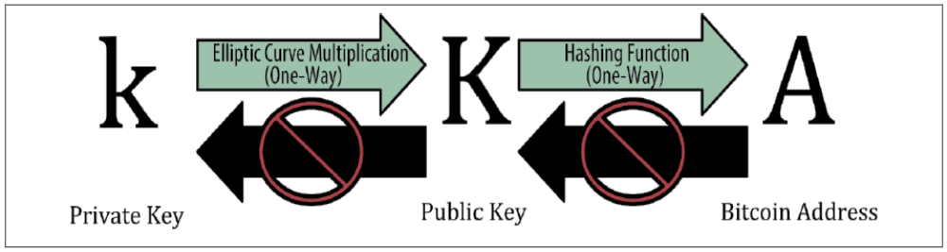
Wallet
Uses Public Key Cryptography
To spend ether assigned to the address owner has to produce Signature corresponding to the address.

Slide 19
Accounts and Wallets
• Accounts:
• Two Kinds:
• External Owned Accounts - (EOA): owned
by person
• Contract Accounts: owned by code
• Allow for interaction with the blockchain
• Wallets:
• A set of one or more external accounts
• Used to store/transfer Ether
Every EOA is associated with a nonce, a counter that increments with every transaction.

Slide 20
Gas and Gas Cost
• Problem: Cannot tell whether or not a program will run infinitely or program has flawed code. DoS attack
• Solution: charge fee per computational step to limit infinite loops and stop flawed code from executing
• Gas Price: current market price of a unit of Gas (in Wei). Depend on market price of ether.
• Gas Limit: maximum amount of Gas user is willing to spend
• Gas Cost (used when sending transactions) is calculated by gas used*gasPrice
• Gas used
• normal transaction - 21,000
• smart contracts: depends on resources consumed - instructions executed and storage used
• What if gas limit < gas cost?
( If the gas limit falls short of the gas needed to process the transaction, the miner will
collect the fee but not change the blockchain's state)
gas limit > gas cost: Excess fees are refunded to the account that issued the transaction

Slide 21
IPFS (Inter Planetary File System)
is a protocol and peer-to-peer network for storing and sharing data in a distributed file system
The medical files are uploaded to IPFS, and it returns a hash. Using the hash, the file can be identified using the provided IPFS gateway.
Storing files in blockchain directly is very expensive. It takes roughly about $100 for storing a 120 kB PDF file into blockchain, but storing 256bit Hash string returned from IPFS into blockchain takes only 2.7 cents based on the gas prices.

Slide 22
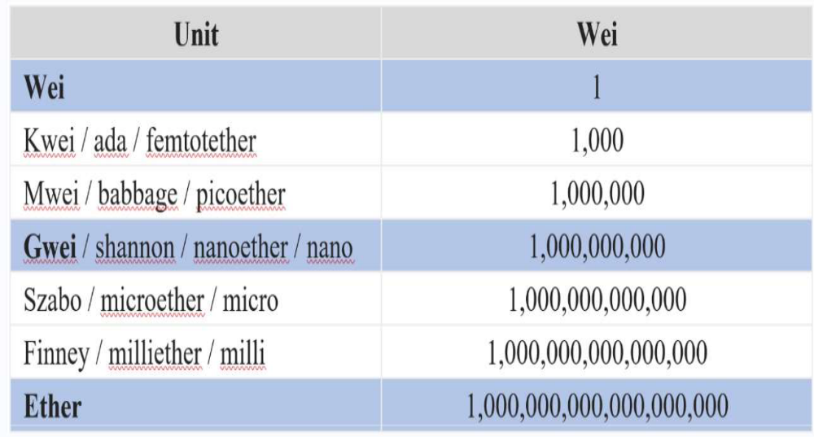

Slide 23
The Address Functions
Address provides single property and five functions.
Property: It’s possible to get the Ether balance in Wei (the smallest Ether denomination)
associated with an address by querying the balance property.
contract AddressExamples
{
address ownerAddress = 0x10abb5EfEcdC09581f8b7cb95791FE2936790b4E;
function getOwnerBalance() public returns (uint) {
uint balance = ownerAddress.balance;
return balance;
}
}

Slide 24
transfer() | To transfer Ether in Wei—If the transaction fails on the receiving side, an exception is thrown to the sender and the payment is automatically reverted (although any spent gas isn’t refunded), so no error handling code is necessary; transfer() can spend only up to a maximum of 2300 gas.
send() | To send Ether in Wei—If the transaction fails on the receiving side, a value of false is returned to the sender but the payment isn’t reverted, so it must be handled correctly and reverted with further instructions; send() can spend only up to a maximum of 2,300 gas.
call() | To invoke a function on the target contract associated with the address (the target account is assumed to be a contract)—An amount of Ether can be sent together with the function call by specifying it in this way: call.value(10)("contractName", "functionName"); call() transfers the entire gas budget from the sender to the called function. If call() fails, it returns false, so failure must be handled in a similar way to send().

Slide 25
destinationAddress.transfer(10);
if (!destinationAddress.send(10))
revert();
destinationContractAddress.call.value(10)(
"contractName", "functionName");

Slide 26
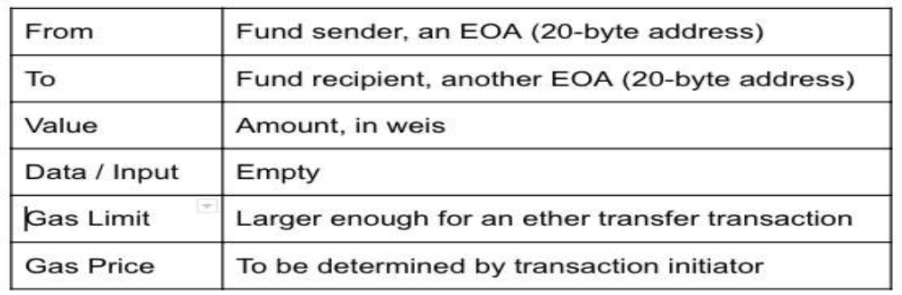
Transactions
A request to modify the state of the blockchain
Launched by an EOA (external transaction) or Contract account
• Types
1. Fund transfer between EOAs:
1. EOA to EOA (ether)
2. EOA to Contract account
3. Contract account to Contract account
4. Contract account to EOA
The signature signs the transaction and the sender's nonce. During transaction
processing, transaction is verified against the nonce value. As a result,
transactions cannot be replayed on the Ethereum network. (To avoid replay attack)

Slide 27
2. Execute a function on a deployed contract:
Executing a function in contract that changes
state is considered a transaction
3. Deploy a contract on Ethereum network

Slide 28
A simple wallet contract
contract Awallet
{
address owner;
mapping (address => uint) public outflow;
function AWallet(){ owner = msg.sender; }
function pay(uint amount, address recipient) returns (bool)
{
if (msg.sender != owner || msg.value != 0) throw;
if (amount > this.balance) return false;
outflow[recipient] += amount;
if (!recipient.send(amount)) throw;
return true;
}
}

Slide 29
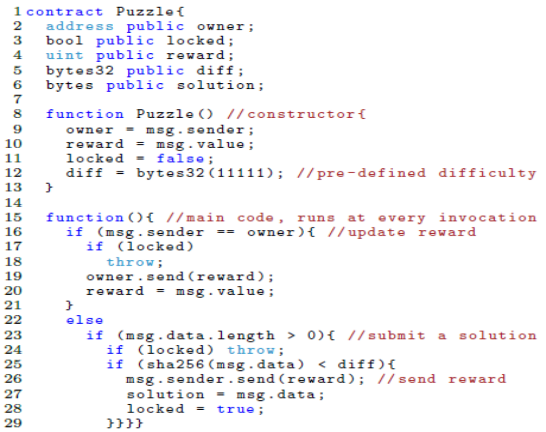
Smart contract that rewards users who solve a computational puzzle

Slide 30
contract Election
pragma solidity 0.4.20;
contract Election { // Model a Candidate
struct Candidate { uint id; string name; uint voteCount; }
// Store accounts that have voted
mapping(address => bool) public voters;
// Store Candidates
// Fetch Candidate
mapping(uint => Candidate) public candidates;
// Store Candidates Count
uint public candidatesCount;
// voted event
event votedEvent (uint indexed _candidateId);

Slide 31
function Election () public
{ addCandidate("Candidate 1");
addCandidate("Candidate 2"); }
function addCandidate (string _name) private {
candidatesCount ++;
candidates[candidatesCount] = Candidate(candidatesCount, _name, 0); }
function vote (uint _candidateId) public
{ // require that they haven't voted before
require(!voters[msg.sender]);
// require a valid candidate
require(_candidateId > 0 && _candidateId <= candidatesCount);
// record that voter has voted
voters[msg.sender] = true;
// update candidate vote Count
candidates[_candidateId].voteCount ++;
// trigger voted event
votedEvent(_candidateId);
}

Slide 32
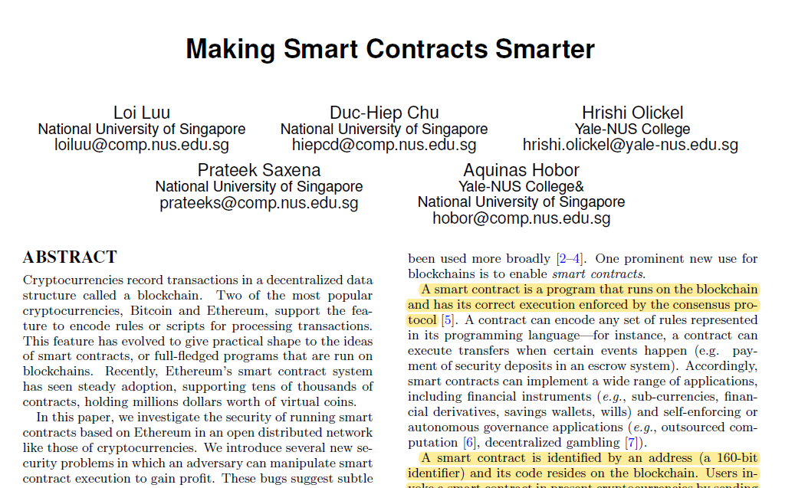

Slide 33
SECURITY BUGS IN CONTRACTS
Transaction-Ordering Dependence
1. Suppose person sends the transaction which has solution of the puzzle. Attacker can see this transaction and sends his own transaction before the person’s transaction gets processed (also Called front run attack).
2. Person sends the transaction which has solution of the puzzle. Around same time owner sends transaction to reduce the prize money.

Slide 34
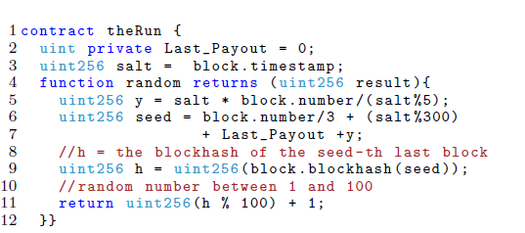
Timestamp Dependence

Slide 35
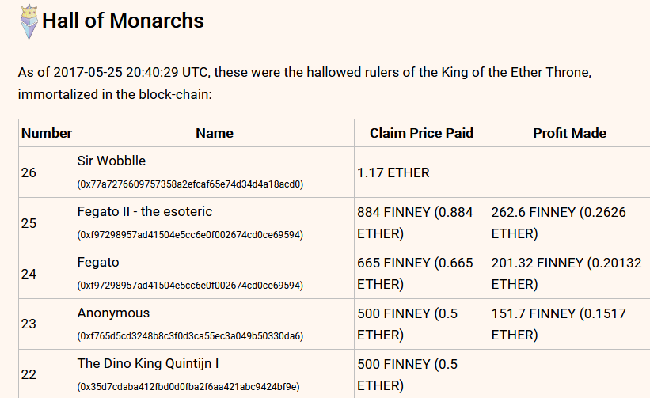
Mishandled Exceptions
King of Ether: It allows users to claim as king of Ether" by paying some amount of Ether that the current king requires

Slide 36
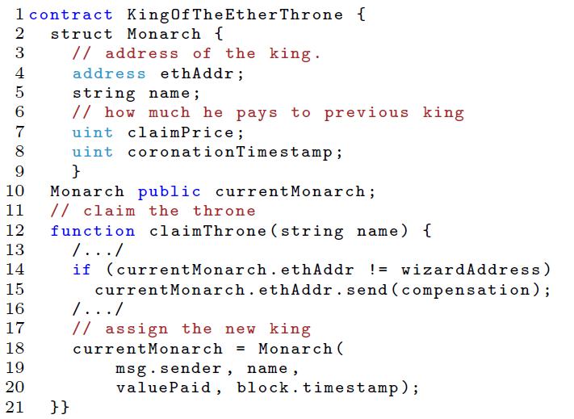
Mishandled Exceptions

Slide 37
Reentrancy Vulnerability
Fallback Function:
In solidity, fallback function is declared without any name. This function cannot have
arguments and cannot return anything.
A contract can have exactly one unnamed function. It is executed on a call to the
contract if none of the other functions match the given function identifier (or if no
data was supplied at all).
Furthermore, this function is executed whenever the contract receives plain
Ether (without data). Additionally, in order to receive Ether, the fallback function
must be marked payable. If no such function exists, the contract cannot receive
Ether through regular transactions.
In the worst case, the fallback function can only rely on 2300 gas being available
(for example when send or transfer is used), leaving not much room to perform other
operations except basic logging.
Like any function, the fallback function can execute complex operations as long as
there is enough gas passed on to it.

Slide 38
Gasless send
2300 units of gas only allow to execute a limited set of byte- code instructions, e.g. those which do not alter the state of the contract. To send the ether 2300 units of gas is enough. In any other case, the call will end up in an out-of-gas exception.
contract C {
function pay(uint n, address d){
d.send(n); } }
contract D1 {
uint public count = 0; // fails with an out-of-gas exception
function() public payable { count++; }
}
contract D2 { function() public payable {} } // succeds

Slide 39
DAO
DAO stands for decentralized autonomous organization and created by the Slock.it. It was a virtual venture capital fund that is governed by the investors of the DAO.
idea: Funds raised from the investors, the token holders, are pooled. These money can be used to fund their startup and other startups of their choice (voting).
The DAO launched on 30th April, 2016
The DAO contract raised about $150M before being attacked
However, on 16 June 2016, the DAO got hacked and siphon off $60 Million.

Slide 40
Reentrancy
Because the fallback function an attacker was able to re-enter the caller function.
contract Bob {
bool sent = false;
function ping(address c) {
if (!sent) {
c.call.value(2)();
sent = true;
}}}
contract Mallory {
function() {
Bob(msg.sender).ping(this);
} }

Slide 41
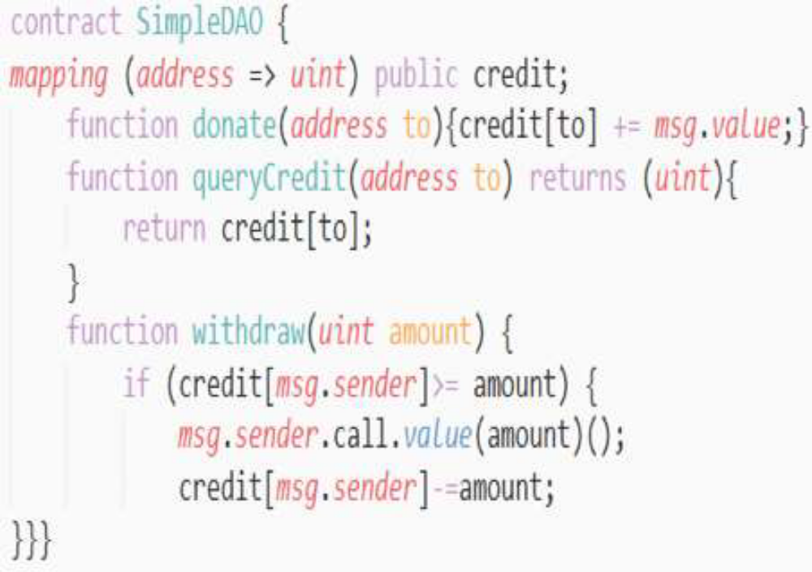
The DAO Code (simplified)

Slide 42
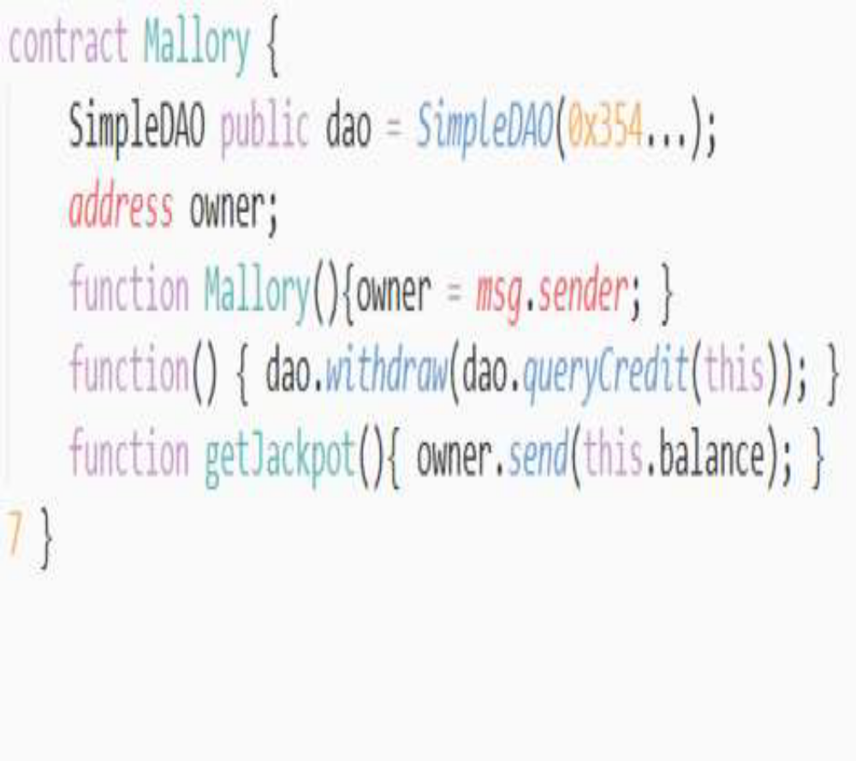
The DAO Attack (Simplified Version)
To perform the attack:
• Deploy a contract
Mallory shown right
• Donate some Ether
for Mallory and
invoke the
withdraw() function

Slide 43
Looping until:
Out of gas
Stack limit is reached
the balance of DAO
becomes zero
…
Mallorry’s
fallback
Withdraw
Mallorry’s
fallback
Withdraw
Withdraw
Mallorry’s
fallback

Slide 44
The Hard-Fork Proposal
to ask the miners to completely unwind the theft and return all ether to The DAO, through forking. This way they managed save some money

Slide 45
THE Oyente TOOL
developers to write better contracts.
users to avoid invoking problematic contracts.
It take contract bytecode and converts it into Control Flow Graph (CFG)
Loi et al. discovered that 8,833 out of 19,366 existing Ethereum smart contracts are vulnerable. They have reported the security bugs on Ethereum smart contract based on Transaction-Ordering Dependence, Timestamp Dependence, Mishandled Exceptions and Reentrancy Vulnerability.
How to install and use Oyente tool
https://medium.com/coinmonks/how-to-install-and-use-oyente-a-smart-contract-analyzer-5251731e4aab
Tarun Kumar Janamaddi (CSE, NIT Trichy)

Slide 46
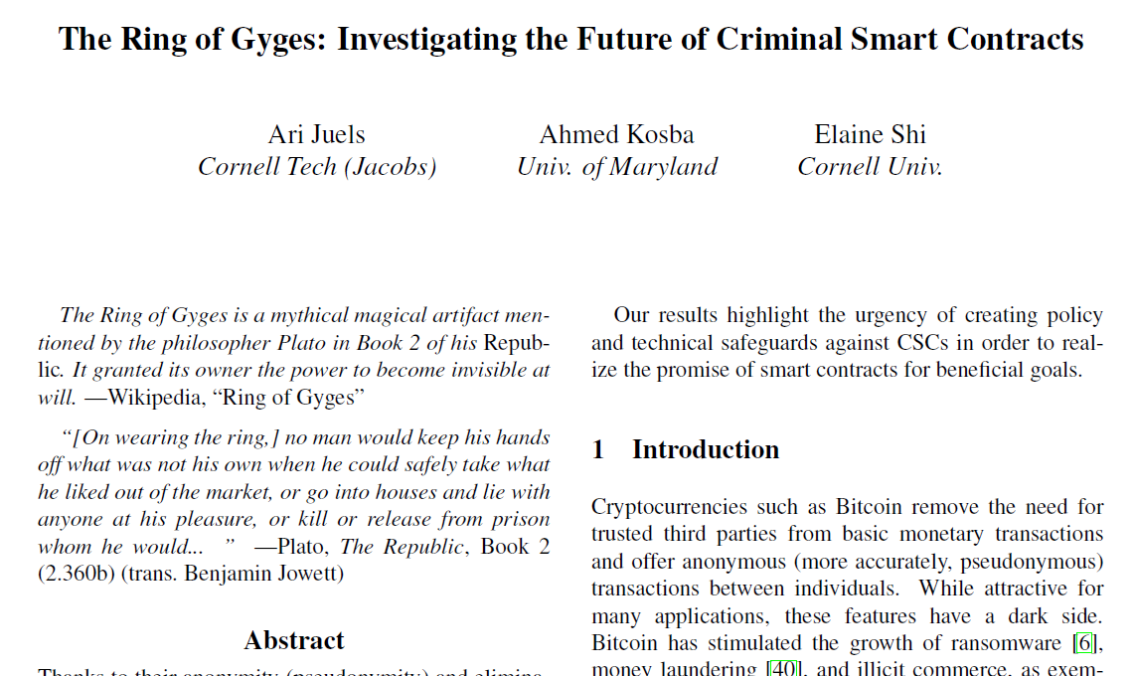

Slide 47
Criminal Smart Contracts (CSC)
Three types of crime using CSC:
Leakage / sale of secret documents. For example pre-release Hollywood films, government secrets.
Theft of private keys.
“Calling-card” crimes, a broad class of physical world crimes (murder, arson, etc.)
Leakage / sale of secret documents:
a contractor C who wishes to sell a piece of content M.

Slide 48
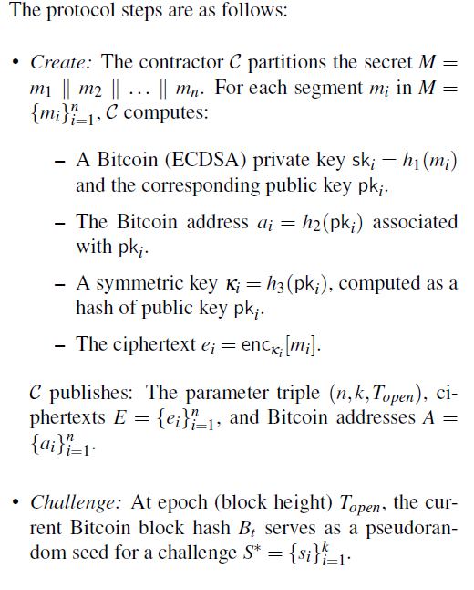

Slide 49
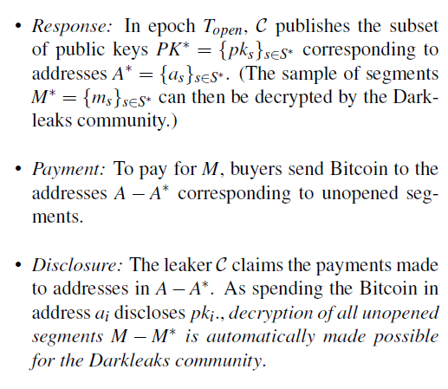
h1 = SHA-256, h2 = RIPEMD-160(SHA-256()), and h3 = SHA-256(SHA-256()).
Ari Juels et al. suggested that suitable set of general system participants is empowered to delete a contract from the Blockchain.

Slide 50


Slide 51

Definitions
Let G₁ and G₂ be abelian groups, written additively.
Let n be a prime number such that [n]P for all P in G₁ and G₂ .
Let G₃ be a cyclic group of order n, written multiplicatively.
Then a pairing is a map:
(Bilinearity)
(Non-Degeneracy)

Slide 52


Properties of Bilinear Pairings

Slide 53
Proxy re-encryption:
Blaze, Bleumer and Strauss(BBS) presented a new primitive called proxy re-encryption in1998. PRE allows semi trusted proxy to convert a ciphertext for Alice into a ciphertext for Bob without knowing the message.

Slide 54
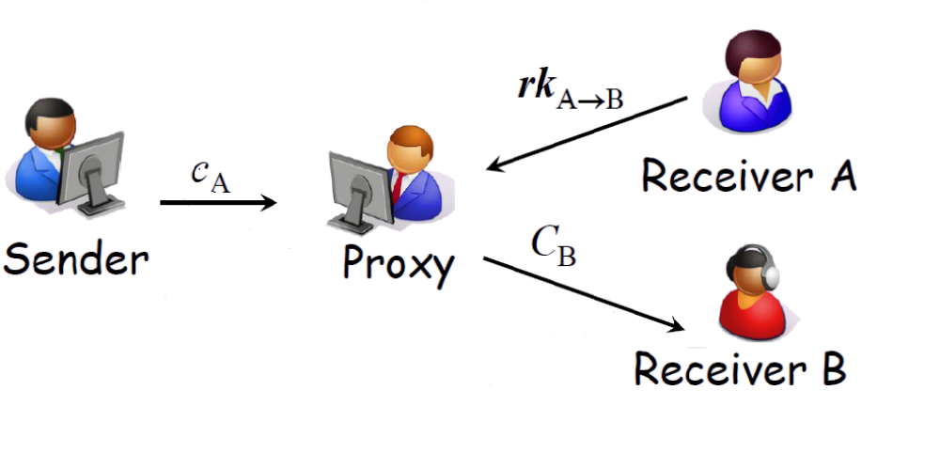
Proxy re-encryption:
Blaze, Bleumer and Strauss(BBS) presented a new primitive called proxy re-encryption in1998. PRE allows semi trusted proxy to convert a ciphertext for Alice into a ciphertext for Bob without knowing the message.

Slide 55
ElGamal Cryptosystem

Slide 56
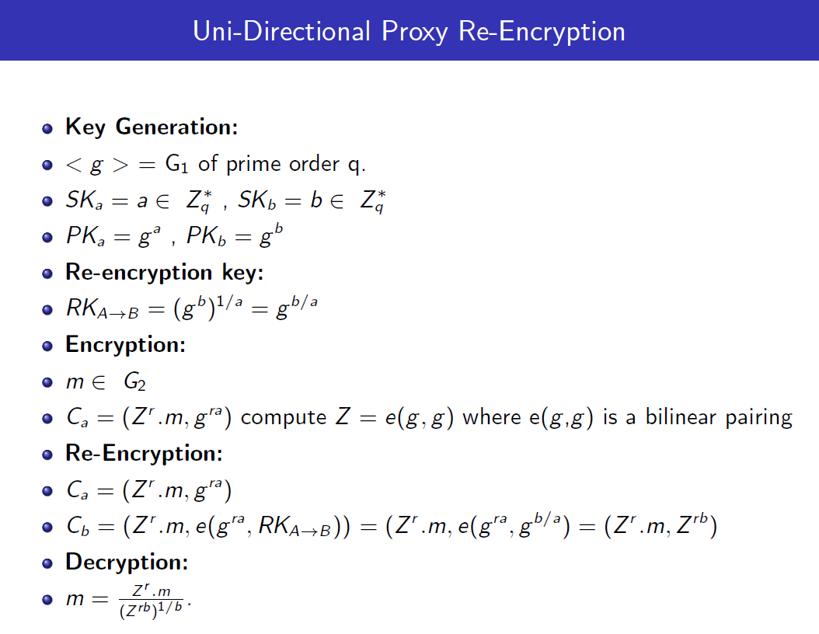

Slide 57
Secure Distributed Medical Record Storage Using Blockchain and Emergency Sharing using Multiparty Computation (BSC 2021)
Providing hospitals with quick access to the medical records of patients who are in critical condition. This enables doctors to diagnose the problem more efficiently and give the best treatment
Sharing of medical records needs to be done in a Secure manner without leaking data to potential adversaries.
The sharing should be secure regardless which hospital the patient is admitted to.
The sharing needs to be done with minimal Patient interaction

Slide 58
IPFS (Inter Planetary File System)
is a protocol and peer-to-peer network for storing and sharing data in a distributed file system
The medical files are uploaded to IPFS, and it returns a hash. Using the hash, the file can be identified using the provided IPFS gateway.
Storing files in blockchain directly is very expensive. It takes roughly about $100 for storing a 120 kB PDF file into blockchain, but storing 256bit Hash string returned from IPFS into blockchain takes only 2.7 cents based on the gas prices.

Slide 59
Medical report is encrypted using public key of the person.
Encrypted medical report is kept in IPFS
Person wants to show the medical report to a hospital.
Using hospital’s public key, person computes the proxy re-
encryption key and gives to the hospital.
Hospital re-encrypts the encrypted medical report.
Hospital decrypt the re-encrypted medical report using its private key.

Slide 61
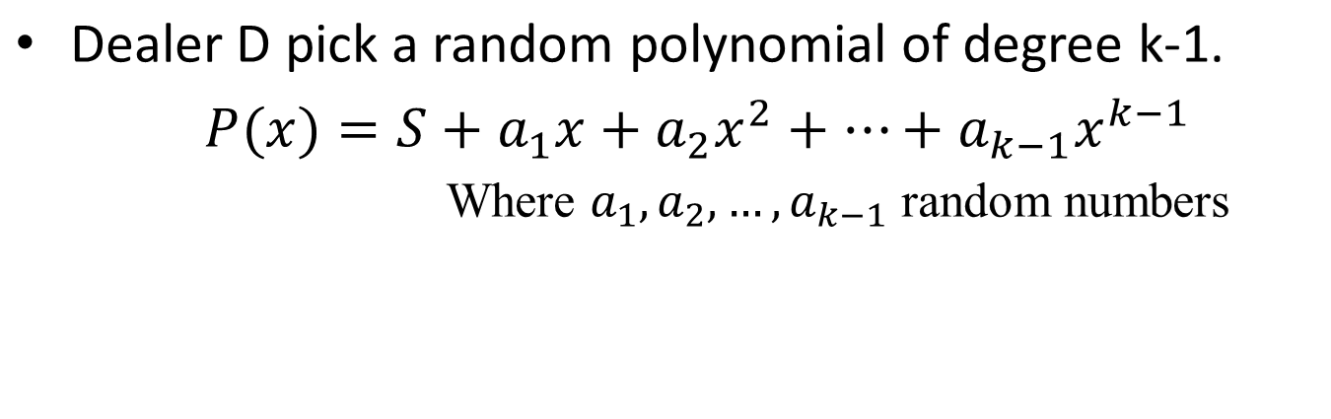
Shamir Secret Sharing (n,k)
Goal is to create n- secret shares of the secret S such that at least k shares are required to compute secret S.

Slide 62
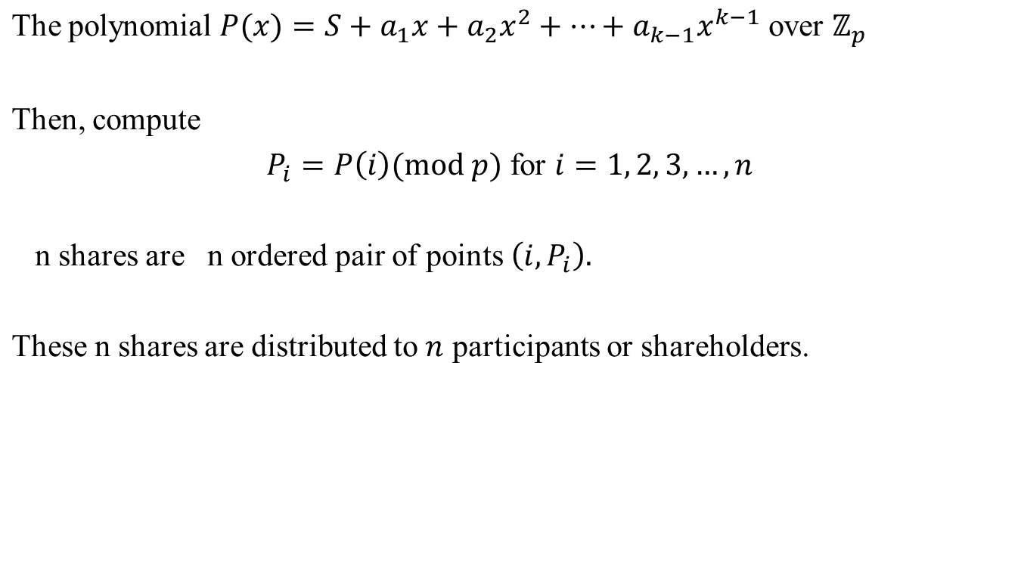
Shares of the Secrete

Slide 63
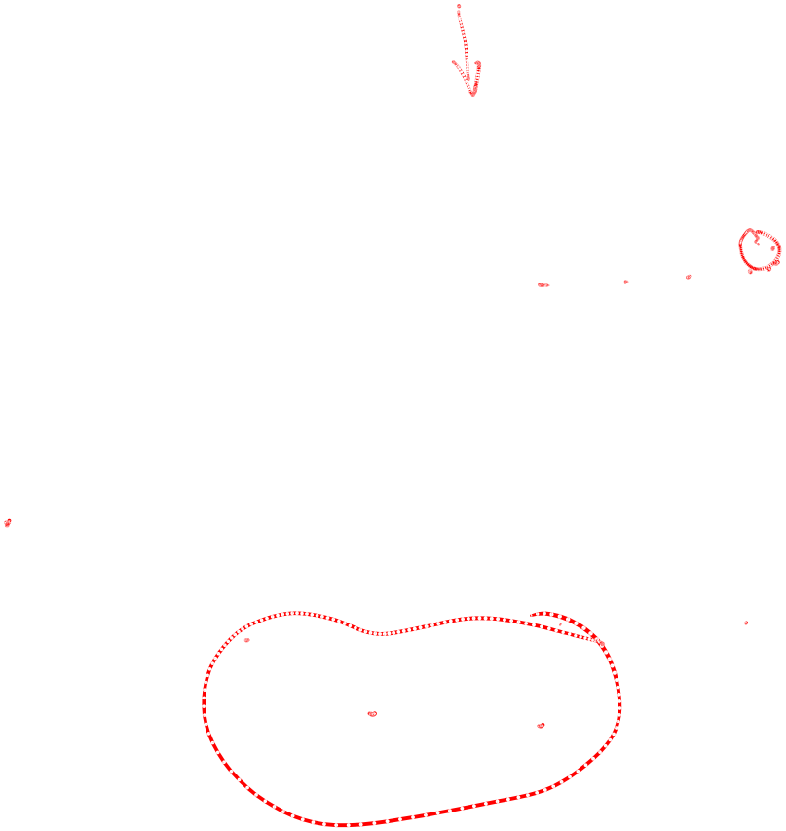
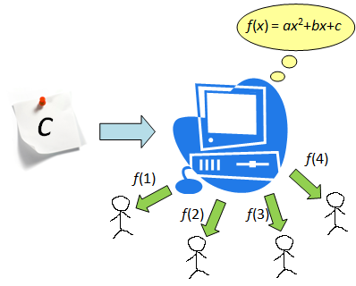
(4,3)

Slide 64
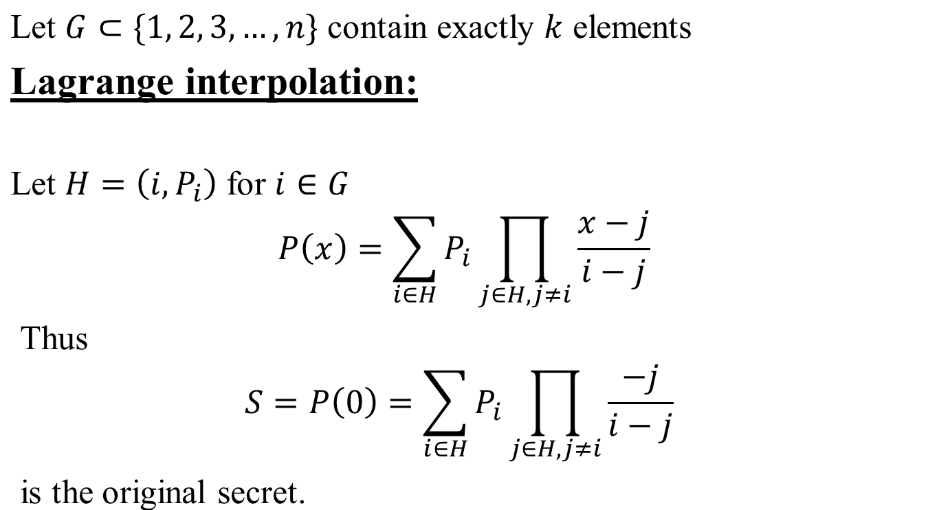
Reconstructing the Secret from k Shares

Slide 65
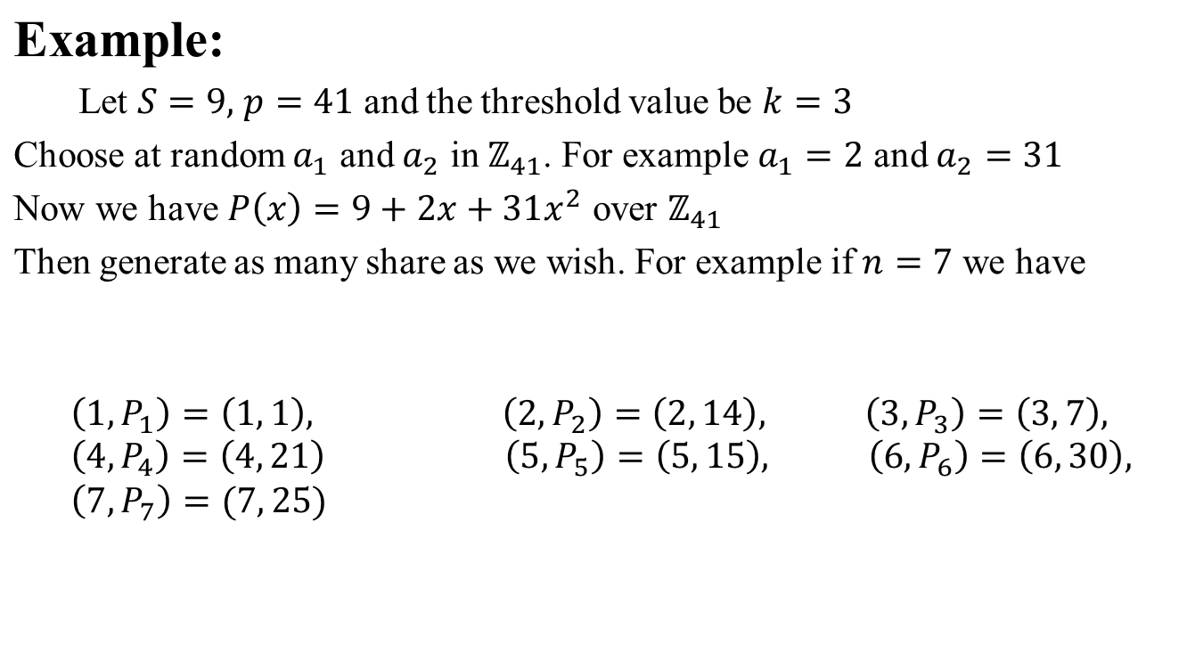

Slide 66
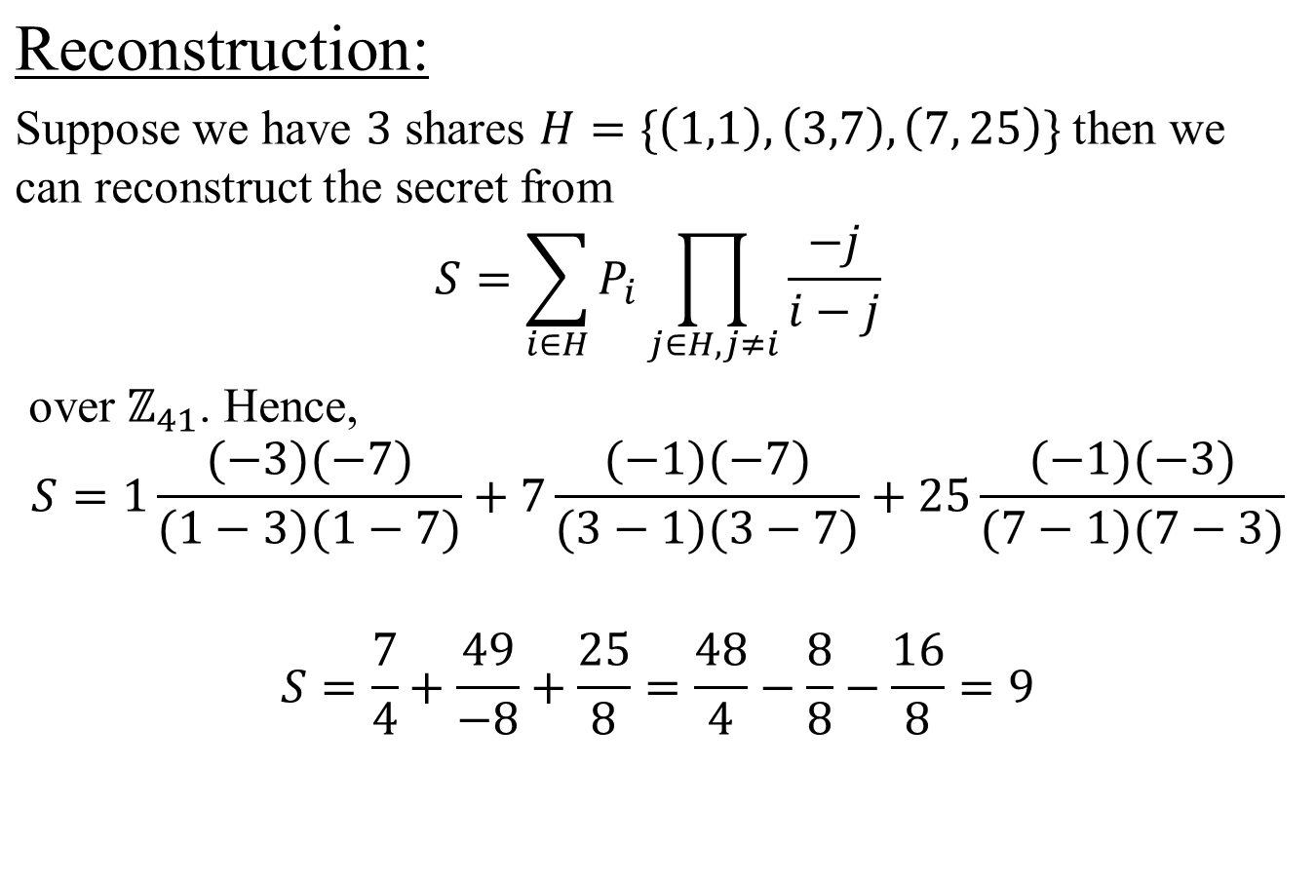

Slide 67
Bitcoin Wallet
Uses Public Key (Elliptic curve) Cryptography
Wallet stores private key and its corresponding address.
To spend Bitcoin assigned to the address owner has to produce Signature corresponding to the address.
Notes:
Wallet does not store money. Wallet queries to the Blockchain for all unspent transaction output (UTXO) for all his bitcoin addresses to display their balances

Slide 68

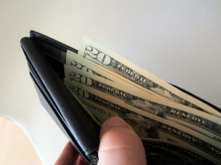
Hot storage
Cold storage
online
offline
hot secret key(s)
payments
cold secret key(s)
address(es)
address(es)
Notes:
Two types of storage. Hot: store key in a file, on your computer or phone

Slide 69
Non-Detrministic Wallet
Generates private key 1…address1
Generates private key 2…address2
Private keys are not related to each other.
Notes:
If these PR keys are lost then there is no way to recover these PR keys. So we may need a scheme in which one can generate the all these PR keys from one key called seed.

Slide 70
Deterministic Wallet
12-24
words
HMAC SHA 512
Master
Private keys
Generate
Private keys and addresses
Notes:
System of deriving keys from single starting point known as SEED. Random phrase that is used to generate your private keys. BIP 032 (Bitcoin Improvement Proposal)
Deterministic wallet uses 12-24 words (Mnemonic) because they are easily remembered. It uses 12-24 Mnemonic word to create seeds. This seed is used to create MPK. This master keys is to create many PR keys and addresses. It is imperative that one has to save these 12-24 words.

Slide 71
Sequential Deterministic Wallet
i=1
SHA 256
1st Private key
1st address
Master
Secret key
i=2
SHA 256
2nd Private key
2nd address
Notes:
System of deriving keys from single starting point known as SEED. Random phrase that is used to generate your private keys.
Deterministic wallet uses 12-24 words (Mnemonic) because they are easily remembered. It uses 12-24 Mnemonic word to create seeds. This seed is used to create MPK. This master keys is to create many PR keys and addresses. It is imperative that one has to save these 12-24 words.

Slide 72
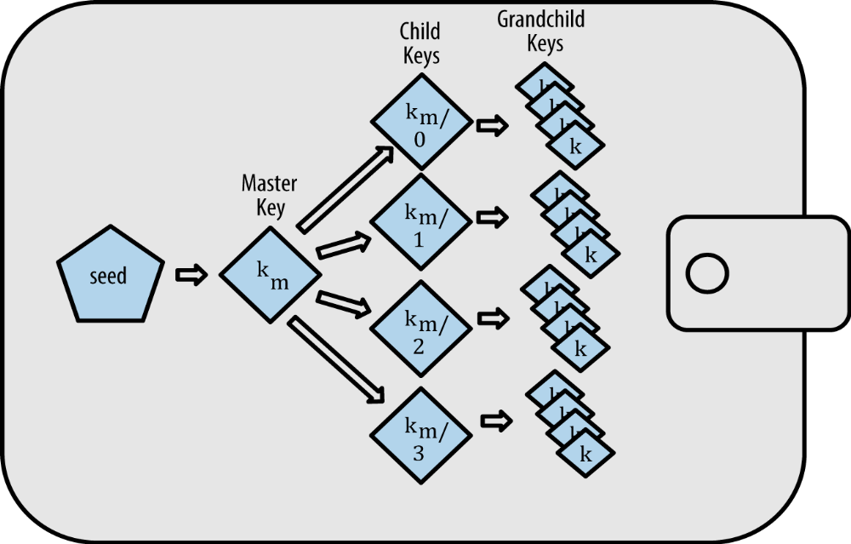
Hierarchical Deterministic Wallet
Notes:
Suppose organization has many department and each department requires some address to receive the payment and to pay the bill. Keys can be safely kept by the department. By chance the keys are lost then can be recovered by the seed which should be kept in very very safe place.

Slide 73
Hierarchical Deterministic Wallet
Parent private key
Parent public key
HMAC SHA 512
Hash left
256 bits
Hash left
256 bits
Hash right
256 bits
Child Chain code
Index num i
32 bits
Parent chain
code c
Child Private key
Parent private key
Hash left
256 bits
+
Notes:
System of deriving keys from single starting point known as SEED. Random phrase that is used to generate your private keys.
Deterministic wallet uses 12-24 words (Mnemonic) because they are easily remembered. It uses 12-24 Mnemonic word to create seeds. This seed is used to create MPK. This master keys is to create many PR keys and addresses. It is imperative that one has to save these 12-24 words.

Slide 74
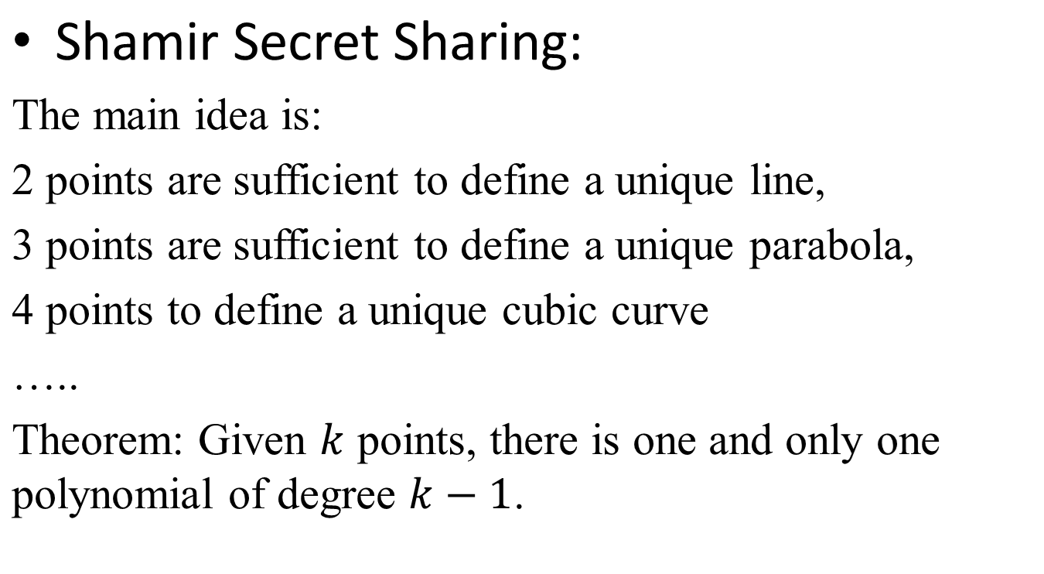
Back up Schemes for Secret Key
Notes:
When we are having sensitive and highly important It is not a good idea to keep the whole secret alone at a single place. To solve this problem, divide the original secret into many parts. There are rules to divide the original secret and to reconstruct the original secret. Mathematics is important here.
So that it will increase the security of the original secret

Slide 75
ECDSA - Elliptic Curve Digital Signature Algorithm
  Public Parameters: Cyclic elliptic group over GF(p) with generator G.
Key generation:
      Private Key = a (1<a < p-1)
      Public Key = P_{A} = a * G = Point on a curve
Signature Generation:
For signing a message m by sender A, using A’s Private key d_{A}
and Public key Q_{A} = d_{A} * G
Calculate e = SHA-256(SHA-256(m)),
Select a random integer k from [1,p − 1]
Calculate r = x₁ (mod p), where (x₁, y₁) = k * G. If r = 0, go to step 2
Calculate s = k ⁻ ¹(e + d_{A}r)(mod p). If s = 0, go to step 2
The signature is the pair (r, s)

Slide 76
Signature Verification:
For B to authenticate A's signature, B must have A’s Public key Q_{A}
1. Verify that r and s are integers in [1,n − 1]. If not, the signature is invalid
2. Calculate e = SHA-256(SHA-256(m)) ,
3. Calculate w = s ⁻¹ (mod n)
4. Calculate u₁ = ew (mod n) and u₂ = rw (mod n)
5. Calculate (x₁, y₁) = u₁G + u₂Q_{A}
6. The signature is valid if x₁ = r(mod n), invalid otherwise
u₁G + u₂Q_{A} = e s⁻¹ G + r s⁻¹ aG
= (e + d_{A} r) s⁻¹ mod n
= k G
= (x, y)

Slide 77
malleable signature: Given signature on message m, third party can use it to compute another valid signature on same message without knowing the private key.

Slide 78
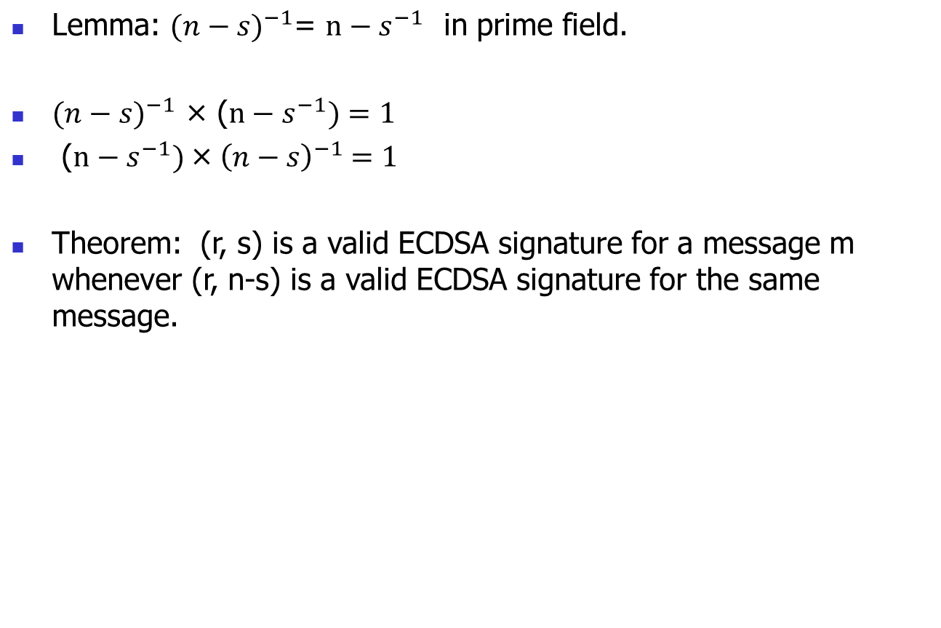
ECDSA Signature is malleable:
10.<number>

Slide 79
Signature Verification:
For B to authenticate A's signature, B must have A’s Public key Q_{A}
1. Verify that r and s are integers in [1,n − 1]. If not, the signature is invalid
2. Calculate e = SHA-256(SHA-256(m)) ,
3. Calculate w = (n-s) ⁻¹ (mod n)
4. Calculate u₁ = e (n-s) ⁻¹ (mod n) and u₂ = r (n-s) ⁻¹ (mod n)
5. Calculate (x₁, y₁) = u₁G + u₂Q_{A}
6. The signature is valid if x₁ = r(mod n), invalid otherwise
u₁P + u₂Q_{A} = e (n-s) ⁻¹ G + r (n-s) ⁻¹ aG
= (n-s) ⁻¹ (e + ar) G mod n
= (n-s⁻¹)(e + ar) G mod n
= n (e + ar) G mod n - s⁻¹ (e + ar) G mod n
= - s⁻¹ (e + ar) G mod n
= - k G
= (x, - y)

Slide 80
The total gas consumed by all transactions in a block is limited. This ensures that the time needed for processing and propagating a block remains sufficiently small, allowing for an adequately-decentralized network. Currently that limit is around 8 million gas units. Simple arithmetic operations cost 3 gas units and the average block time is 15s. The total Ethereum network can, therefore, perform less than 1
80k arithmetic operations per second.
Contracts are written in specic programming languages such as Solidity [Sola]. Once compiled to bytecode, the contract can be read and executed by the Ethereum virtual machine (EVM), a sandboxed and isolated runtime environment. The EVM has access to a global persistent storage system and each contract account has separate storage available to it.

Slide 81
THANK YOU

